Slide 1
Forecasting Video Game Sales with Data Mining
Rez Ebrahimi
Ava Shearer
Yuening He

Slide 2
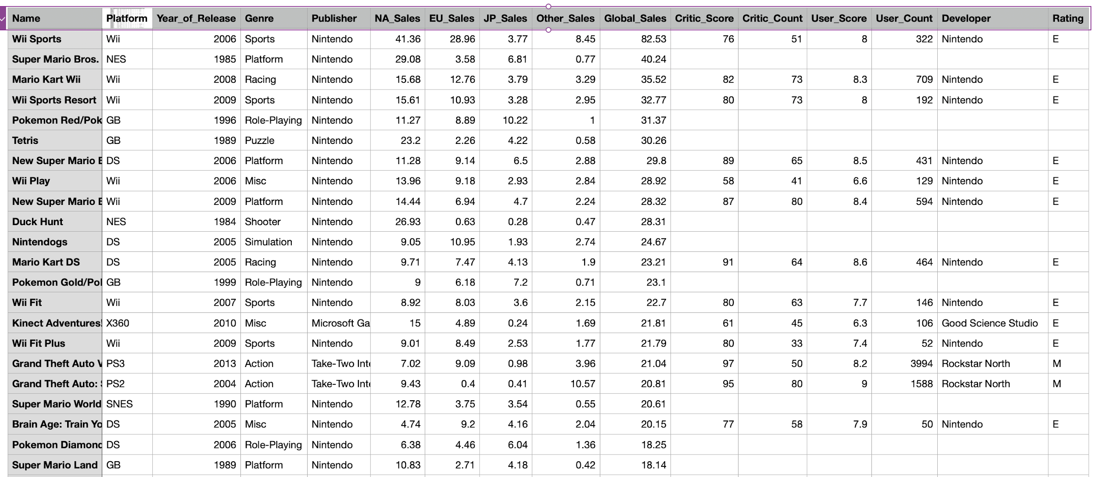
Dataset - Video Game Sales Dataset from Kaggle

Slide 3
Dataset - Video Game Sales Dataset from Kaggle
Size: 16719 rows x 16 columns
Features:
Categorical: Name, Platform, Genre, Publisher, Developer, Rating
Numeric: Year_of_Release, NA_Sales, JP_Sales, Other_Sales, Global_Sales, Critic_Score, Critic_Count, User_Score, User_Count
Goal
To analyze Video Game Sales dataset and make predictions by performing multiple data mining algorithms

Slide 4
Preprocessing
Check for obvious outliers
Independent variable: Critic_Score
Dependent variable: Global_Sales
Remove outliers if any

Slide 5
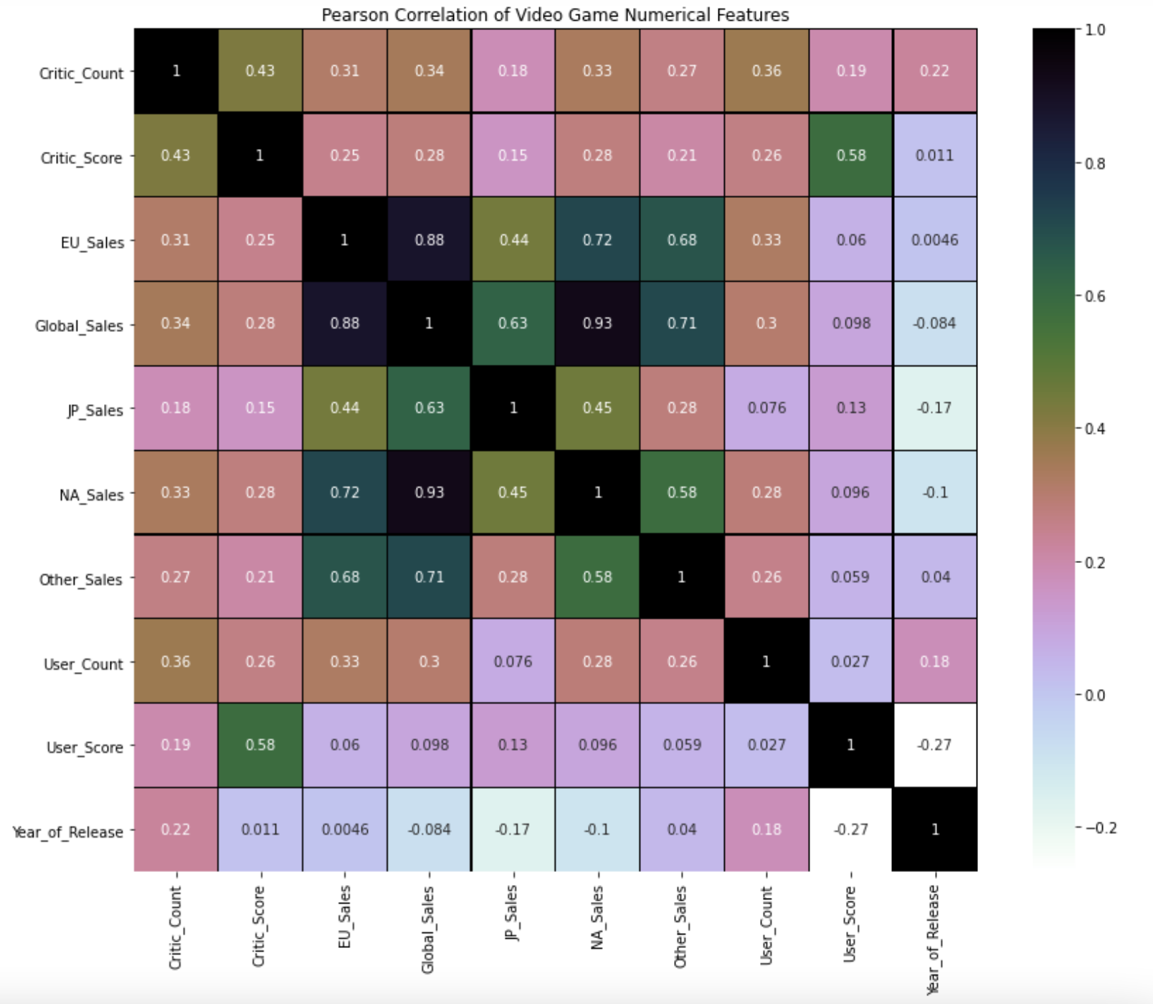

Slide 6
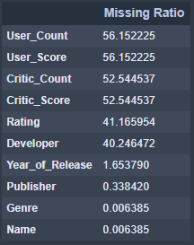
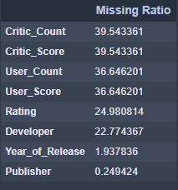
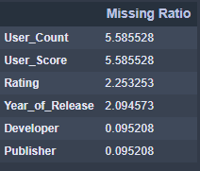
Check for missing values:
Critic_Score may be the most important independent variable, but 52.5% of its values are missing.
Check missing ratios for Critic_Score across multiple major platforms
39.5% is still too big → drop all rows with missing Critic_Score

Slide 7
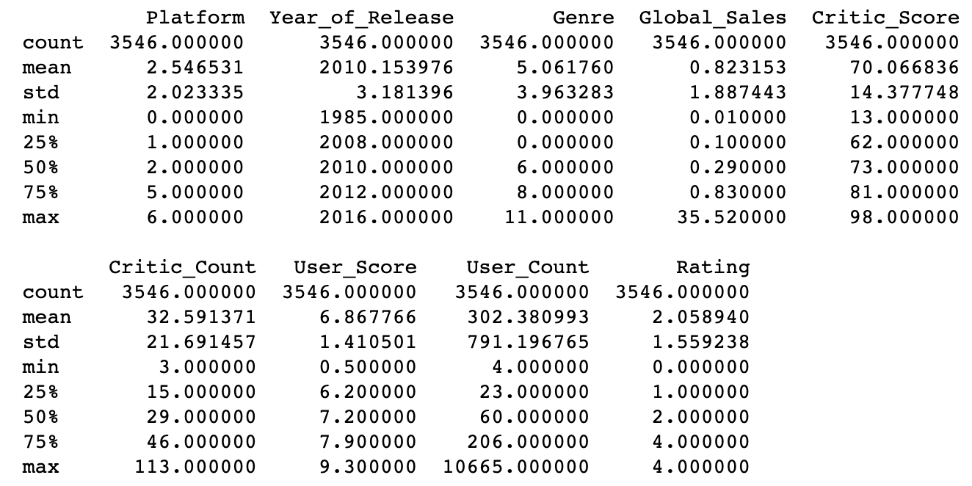
Data PreProcessing
After removing rows with missing Critic_Score, the size of our dataset is (5673, 16)
Fill missing values with mode: Publisher, Developer, Rating
Fill missing values with median: Year_of_Release, User_Score, User_Count
Descriptive statistics for continuous variables

Slide 8
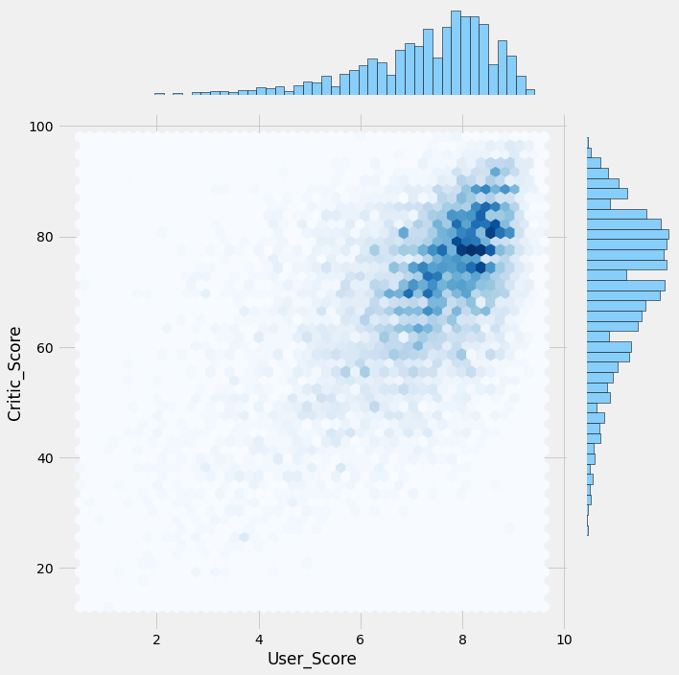
Critic Score and User Score for most of the games is more than 70(Critic_Score) and 7 (User_Score). Most of the games have high score value.

Slide 9
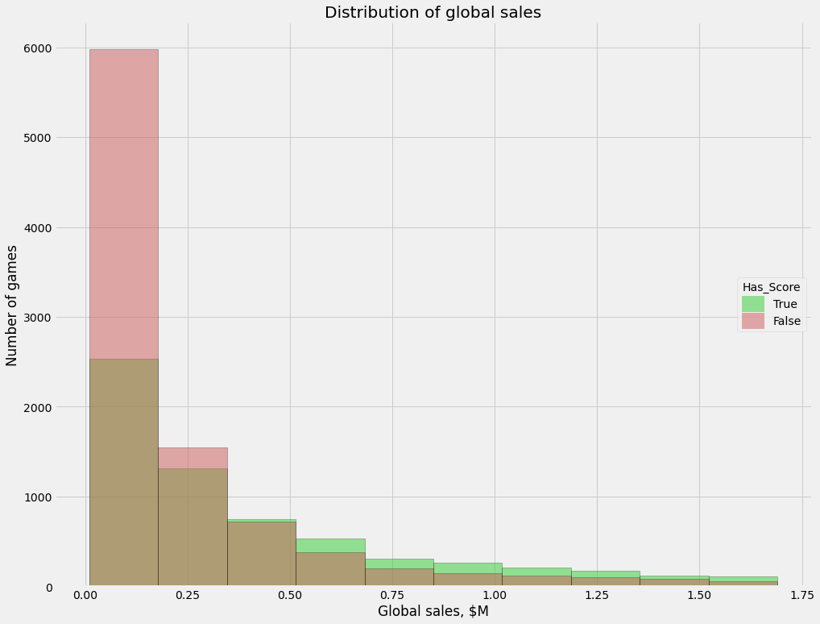

Slide 10
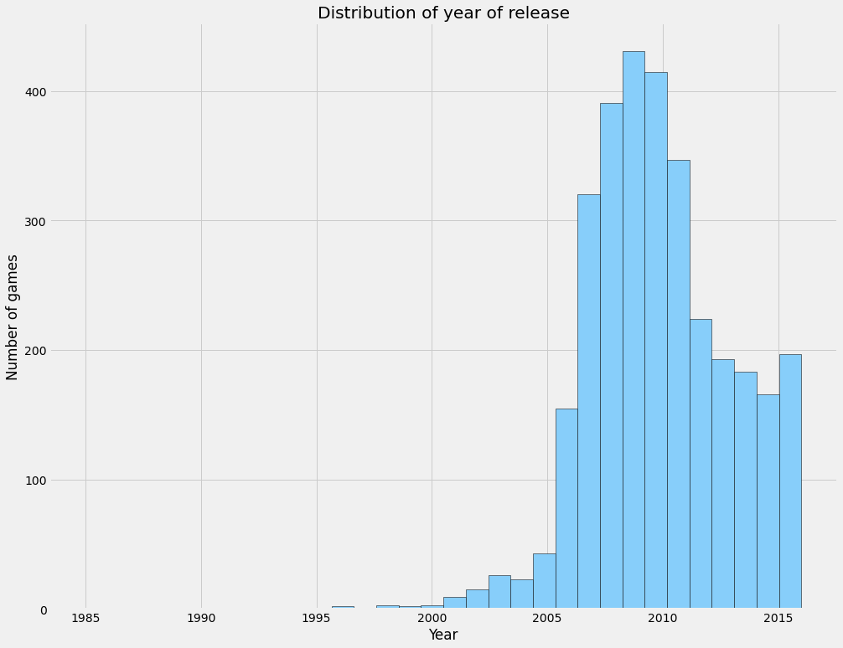

Slide 11
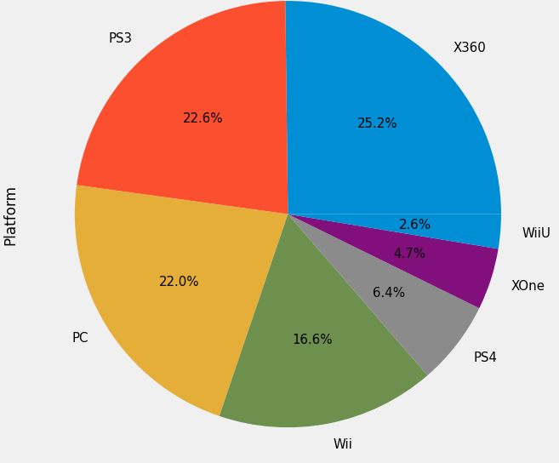

Slide 12
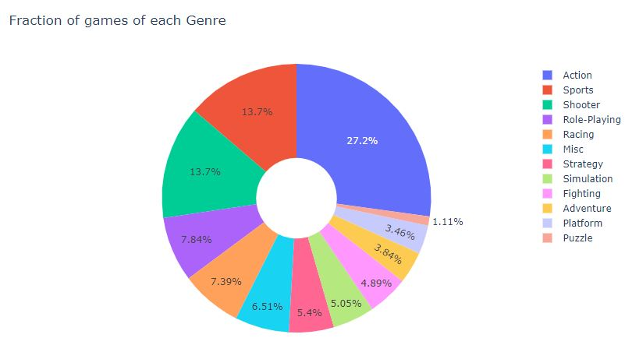

Slide 13
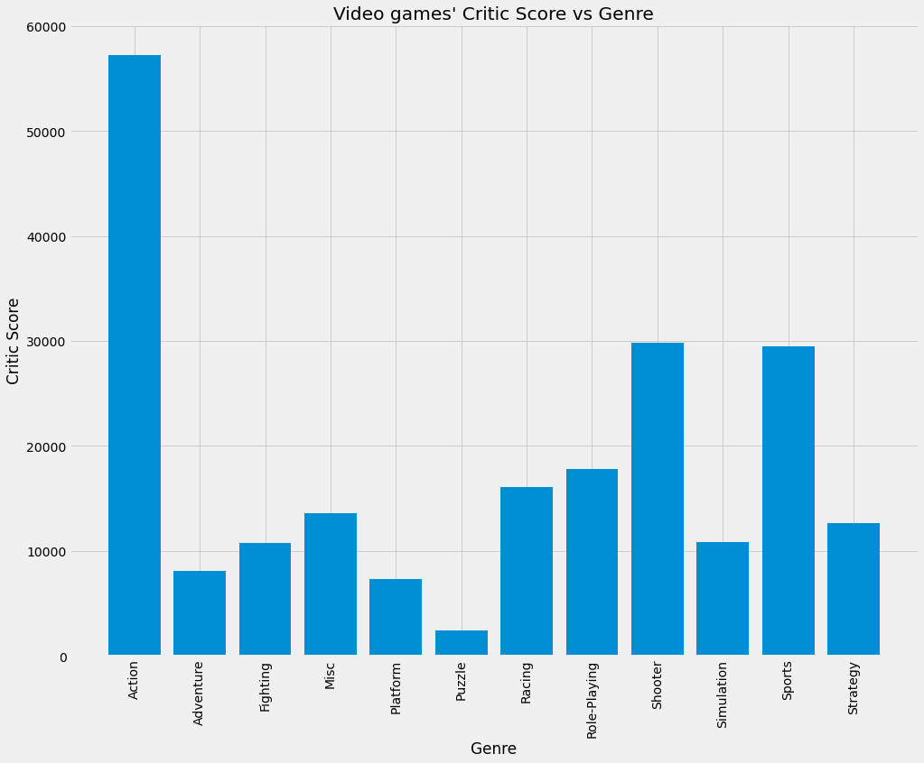

Slide 14
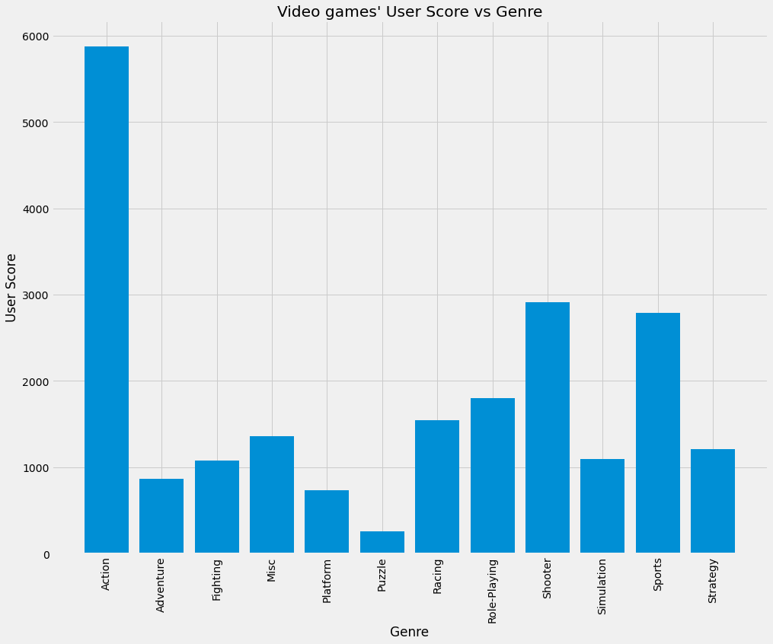

Slide 15
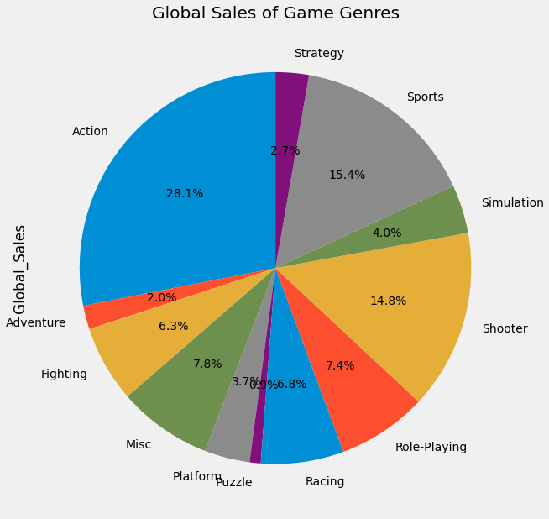

Slide 16
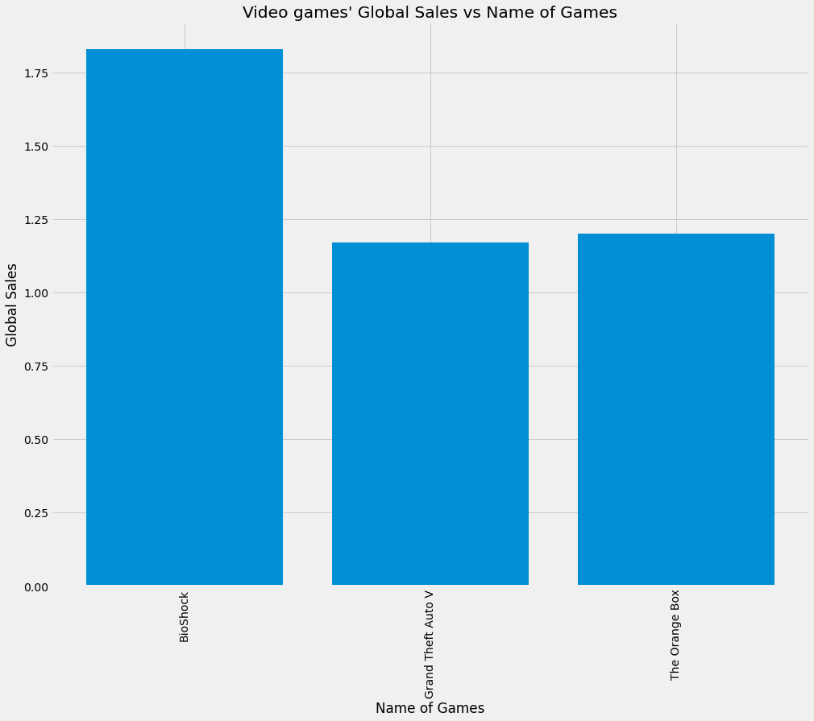

Slide 17
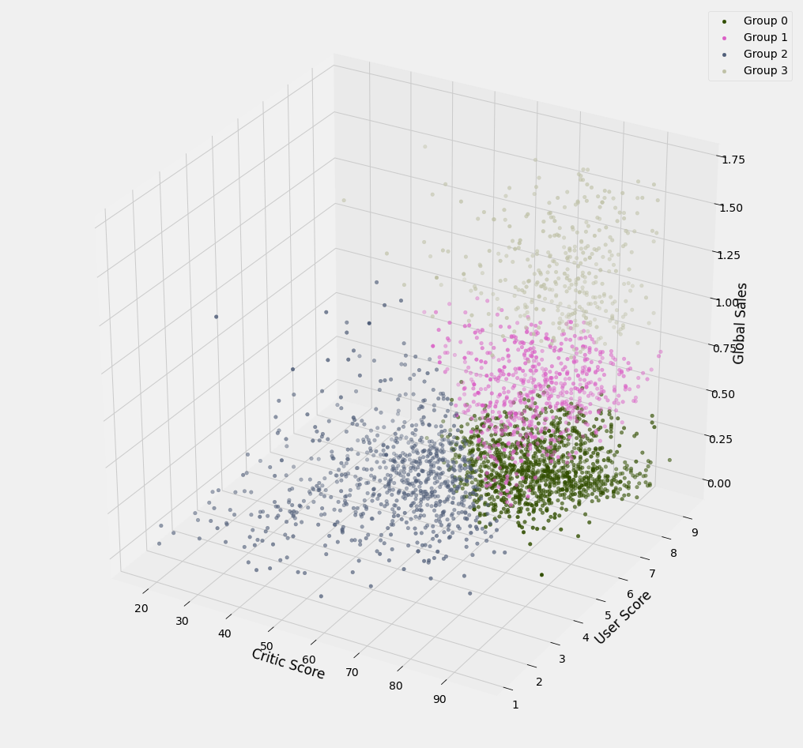

Slide 18
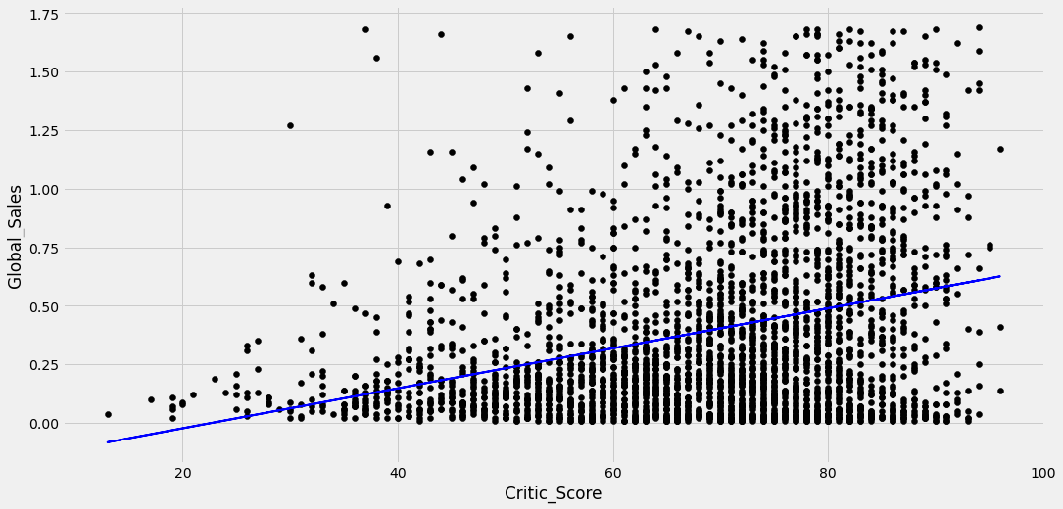

Slide 19
Conclusion
After Data Visualization and Algorithm we used, Critic Score and User Score have the same correlation which means they both work in the postive direction. Games that have Critic and User score have global sales than the ones that don’t have score at all, which also means games that have higher score will have higher global sales. Between all the Genres, Action games have the highest score and global sales, and this tells us that the future of video games is Action games.

